Slide 1
Science Review

Slide 2
Which adaptations might an animal use to trick or escape a predator? Pick 3.
Scent
Gills
Speed
Having a long tail
Body coverings
Lungs

Slide 3
A horse is a __________.
Mammal
Reptile
Bird
Insect
How do you know?

Slide 4
A beetle is a ___________.
Mammal
Insect
Reptile
Bird
How do you know?

Slide 5
A turtle is a ___________.
Mammal
Bird
Reptile
Insect

Slide 6
A robin is a _____________.
Mammal
Bird
Reptile
Insect

Slide 7
A chipmunk is a __________.
Mammal
Bird
Reptile
Insect

Slide 8
What is the difference between a vertebrate and an invertebrate?
Write your answer on your white board.

Slide 9
Inherited means…
A. It must be learned
B. Never changes
C. Adapted from different environments
D. passed down from parents to offspring

Slide 10
Give an example of an instinct or something an animal is born knowing how to do.

Slide 11
Which of the following is using mimicry?
A lion blending in with the grassland
A walking stick bug pretending to be a stick
A goose flies south for the winter
A bear goes into a sleep-like state for the winter

Slide 12
What is the first step of a mammal’s life cycle?
Write your answer on your white board.
Where does a mammal develop before it is born?

Slide 13
Put these 3 steps in order for a frog’s lifecycle:
Nymph/tadpole
Adult
Egg

Slide 14
Put these 4 steps of a lady bug life cycle in order:
Pupa/ Chrysalis
Adult
Larva
Egg

Slide 15
Draw and label a butterfly’s life cycle on your white board.

Slide 16
Which of the following is an inherited trait?
Learning to play the guitar
Getting pierced ears
Having blue eyes
Why is __________ an inherited trait?

Slide 17
Which of the following is an acquired trait?
Having a scar from falling off your bike
Having brown hair
Learning to ride your bike
Why is __________ an acquired trait?

Slide 18
Which of the following is a learned behavior?
Learning to swim
Being very tall
Having freckles
Why is _______ a learned behavior?

Slide 19
Mrs. Moore has brown eyes and blonde hair. She likes to swim and has pierced ears. Which of Mrs. Moore’s characteristics are inherited, learned, and acquired and why?

Slide 20
Mrs. Moore has brown eyes and blonde hair. She likes to swim and has pierced ears. Which of Mrs. Moore’s characteristics are inherited, learned, and acquired and why?
Inherited- brown eyes and blonde, because she had those traits when she was born and it was passed down from her parents.
Learned- to swim, because she had to be taught how to swim.
Acquired- pierced ears, because she was not born with pierced ears, she had to get them later in her life.

Slide 21
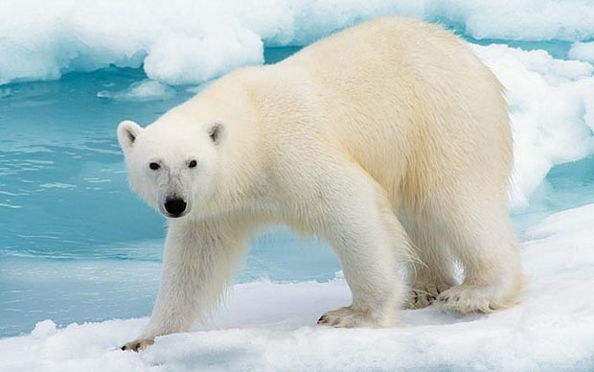
What is one adaptation that this polar bear has?
How does that adaptation help it survive in this artic environment?

Slide 22
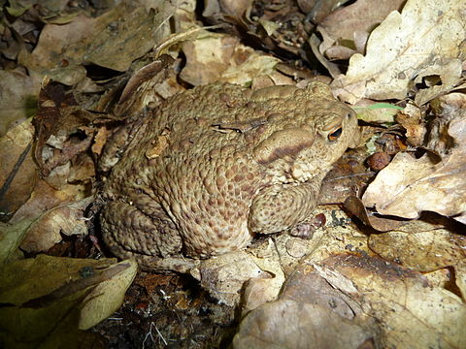
What is one adaptation of this toad?
How does that adaptation help the toad survive?

Slide 23
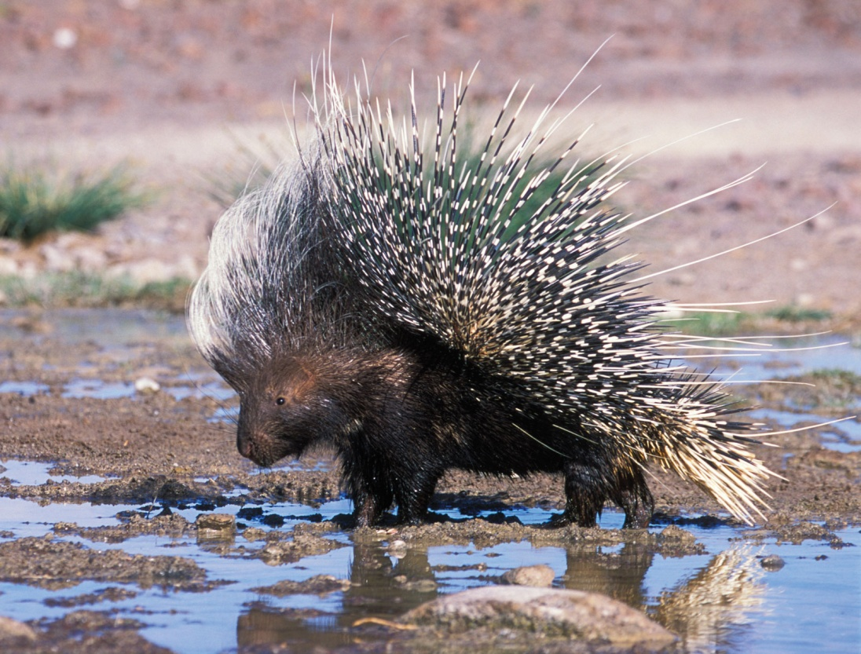
What is one adaptation of this porcupine?
How does that adaptation help it survive?

Slide 24
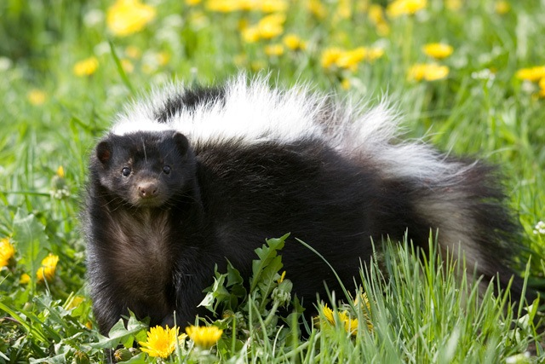
What is one adaptation of this skunk?
How does that help it to survive?

